Slide 1

BSRLM Conference – 13th June 2025 @ Glasgow
Critical Mathematics Education (CME)
Working Group: Promoting Socially Just Mathematics Teaching (PSJMT)
Pete Wright (University of Dundee), Corinne Angier (University of Stirling),
Jane Goodland (University of Manchester), Caroline Hilton (UCL Institute of Education), Sinem Hizli Alkan (Anglia Ruskin University), Gwen Ineson (Brunel University London), Balbir Kaur (University of Nottingham), Cristina Mio University of Glasgow),
Hilary Povey (Sheffield Halam University)

Slide 2
Introduction
Over the past year, the PSJMT research team, drawn from members of the Teaching Maths for Social Justice Network (www.mathsocialjustice.org), has been designing and trialling professional development workshops aimed at promoting socially just pedagogies and practices amongst student/trainee teachers and experienced practitioners.
In this session, we will:
present the aims and design principles of the professional development workshops (Pete – 5 mins)
provide an opportunity to engage with some of the workshop activities and to discuss how these might link to social justice (PSJMT research team – three groups, each looking at 1 of the workshops – 20 mins)
discuss how the workshops might be disseminated and used with teachers (open discussion – 10 mins).

Slide 3
Features of workshops:
Engage with some classroom activities.
Opportunities to talk/discuss/contribute.
Model and discuss pedagogies.
Critically reflect on existing practice.
Question and challenge prior assumptions.
Reflect on constraints/opportunities.
Consider implications for future practice.
Notes:
Outline features of the workshops.

Slide 4
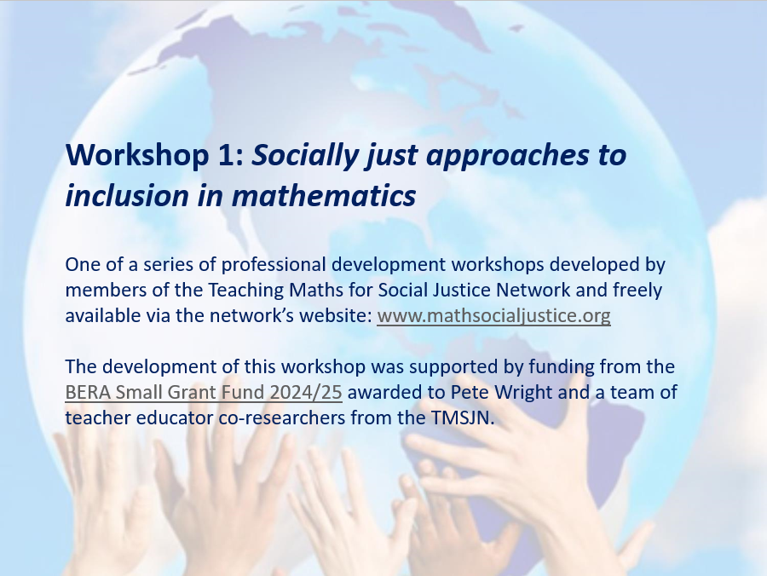
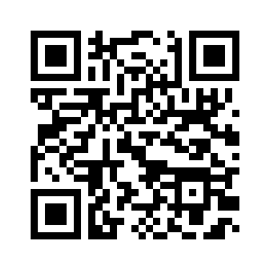
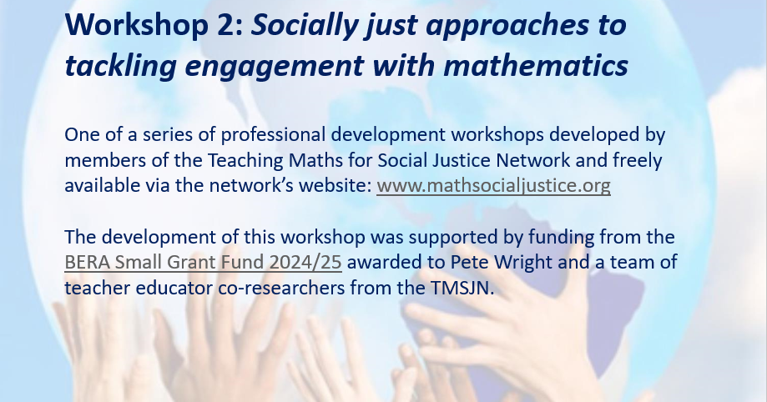
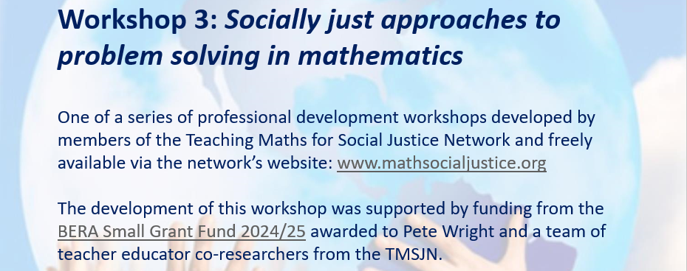
The three professional development workshops:
https://mathsocialjustice.org/prof-dev/
Notes:
Workshops – group discussions
1. SJ approaches to tackling inclusion in maths
Led by Caroline, Jane, Sinem
2. SJ approaches to tackling engagement with maths
Led by Corinne, Hilary, (Pete)
3. SJ approaches to tackling problem solving in maths
Gwen, Cristina, Bal

Slide 5
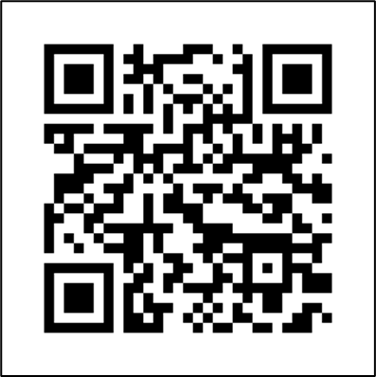
Discussion:
Discuss how the workshops might be disseminated and used with teachers (open discussion).
https://mathsocialjustice.org/prof-dev/

Slide 6
About the CME Working Group:
The CME Working Group (launched in November 2015) is open to all and aims to promote research that brings about positive social change through mathematics education. CME aims to identify and challenge ways in which mathematics is commonly used to maintain the status quo and reproduce inequities in society. It proposes an alternative and empowering conceptualisation of mathematics, which enables people to better understand their social, political and economic situations, and to advocate and bring about changes leading to a more just and equitable society.

