Slide 1
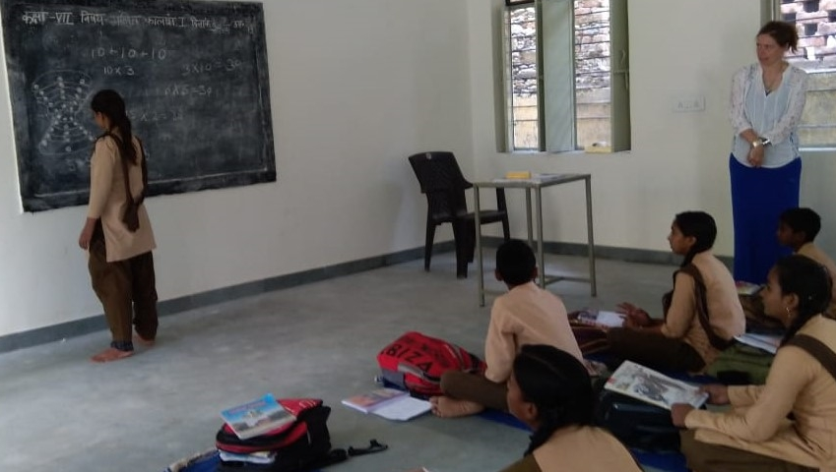
Critical mathematics education Some tensions and challenges
Vinay Kathotia The Open University

Slide 2
Critical Mathematics Education
A disclaimer!
Brief introduction to Critical Mathematics Education
Student-centred activity, student agency
The role of the teacher
The nature of mathematics / mathematics education
Some examples, seeds/stimuli for discussion.
Notes:
New to the field. Many more knowledgeable people. Building on experiences from RME trial – what it means to have a more inclusive and expressive mathematics.
Will consider three aspects relating to the implementation of CME – listed separately but these are overlapping issues (and tie in with teacher professional development).

Slide 3
Critical Mathematics Education (CME)
Critical mathematics education aims to identify and challenge ways in which mathematics is commonly used to maintain the status quo and reproduce inequities in society. It proposes an alternative and empowering conceptualisation of mathematics, which enables people to better understand their social, political and economic situations, and to advocate and bring about changes leading to a more just and equitable society.
Notes:
Definitions are problematic! Will not aim to define CME but will touch on some aspects. Paragraph here from the BSRLM CME Working Group’s introductory statement. Not much about ‘how’ but more an outlining of the aims and aspirations of CME.

Slide 4
A Philosophy of Critical Mathematics Education
“I outline a philosophy of critical mathematics education by addressing conceptions of social justice, mathematics in action, students’ foregrounds, teachers’ life-worlds, sustainability, citizenship, dialogue, and critique. … It is important to be critical with respect to mathematics, which means to be ready to question any form of assumed mathematical knowledge and to question any form of the bringing of mathematics in action. It is also important to be critical by means of mathematics … to be ready to draw on mathematical resources when questioning cases of social injustice.”
(Skovsmose, 2021)
Notes:
Bit more about the ‘what’ and ‘how’ of CME (though one person’s view, Skovsmose, albeit a key researcher and developer of Critical Mathematics Education)
Already, tensions between “critical of” and “critical by means of” (mathematics).
Many routes. Different curricula, key individuals/groups. We will not focus on particular CME approaches, scholars, curricula but more about the experiences of students and teachers involved in CME-related approaches.

Slide 5
1. Student-centred mathematics
How much agency, voice, control do students have?
How critical is this?
“But perhaps the main difficulty is that we do not know what issues are going to emerge as we let the students gain ownership of their learning.” (Civil, 1994)
Notes:
Whether it be foregrounds or backgrounds, constructivism or empowerment.

Slide 6
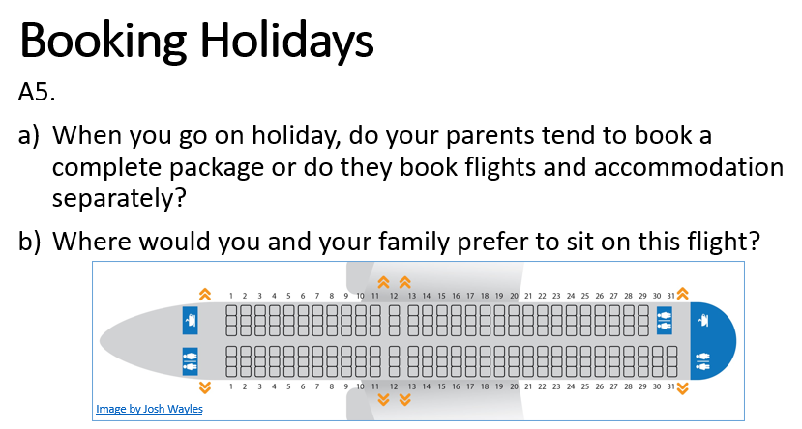
Example from an RME classroom (Year 7)
Eva: “I would sit on the wing.”
Notes:
RME aims to build on students’ experiences. Not just about using context to set the scene. Key models (can) emerge from the chosen contexts and students experiences can help them anchor the relevant mathematics and approaches in their own experiences and activity. Here, re-allotting seating (or in classrooms, theatres, parking lots, …) is a means of interpreting fractions and percentages and relates to bar models, area and number.
But students already had settled ways of seeing and doing mathematics (for many it wasn’t a sense-making or an inclusive activity) and it isn’t a straightforward transition to have them ground and see the mathematics as emergent from their own experiences and activity.

Slide 7
More on RME and engaging students
Gutstein (2006) discusses some of the student related tensions of implementing curricula that students cannot identify with, and the tensions between curricular materials that help develop “mathematical power” but may not help “analyze injustice”.
Contexts such as a school camping and canoe trip served to generate ideas around ratio but Gutstein’s middle school students (from inner-city Chicago) reported that this context had no experiential resonance for them. But they were also happy for the teacher to deploy such contexts.
Notes:
Underlying point – students are much savvier than we may give them credit for. Greater value for transparency and honesty? Work by Pete Wright and others on making mathematical and pedagogical choices visible to learners. https://bera-journals.onlinelibrary.wiley.com/doi/epdf/10.1002/curj.122
Gutstein (2006) praises the Mathematics in Context (MiC, a US middle school implementation of RME) materials for presenting mathematics “as a sensemaking activity” and positioning students “as arbitrators of knowledge” (p. 103). However, while MiC helped his students to develop the necessary “mathematical power” (p. 107), “MiC by itself ... does not challenge students to analyze injustice or see themselves as potential social change agents” (p. 104).
Nor were such contexts relevant to the political and social critique that Gutstein felt was most important for his students’ agency. Gutstein has much work on developing and using contexts more relevant for the social justice challenges for his students – but that may still not fully address student choice and agency.

Slide 8
2. The role of the teacher
Dispositions: How committed do teachers need to be to an equitable society?
Training: How much knowledge do teachers need about topics and pedagogies for such curricula?

Slide 9
Teachers’ motivations for joining the RME trial
Maths ... helps you with your life ... and I don’t care what you’re going to be ... a hairdresser, you’re going to need some maths”
“trying to put the learning in a context that the kids care about and that makes sense to them”
“this ownership of why we use the formulas that we do”
desire to nurture the “weakest” students, “doing the right thing by them”
(Kathotia et al, 2021)

Slide 10
On teachers’ motivations
‘What motivates teachers to develop critically informed citizens in the mathematics classroom?’ (Ghosh, 2021)

Slide 11
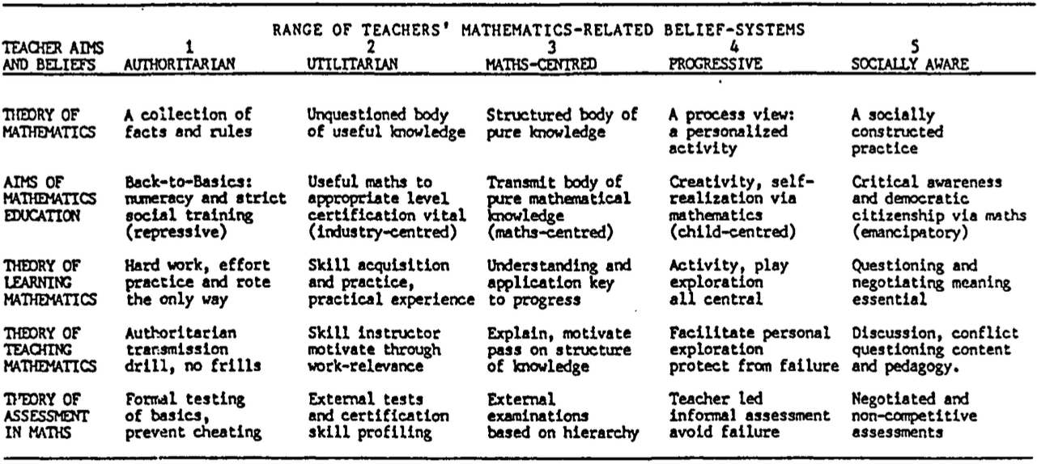
Belief-systems from Ernest (1991), used in (Ghosh, 2021) but without using the ‘progressive nature of the original table’.
Notes:
“Most of the participants did not prioritise ‘socially aware’ or ‘progressive’ beliefs, but, as mentioned in the previous section, they were all committed to developing critically informed citizens in the mathematics classroom in their lesson, albeit to different degrees.” (Ghosh, 2021).

Slide 12
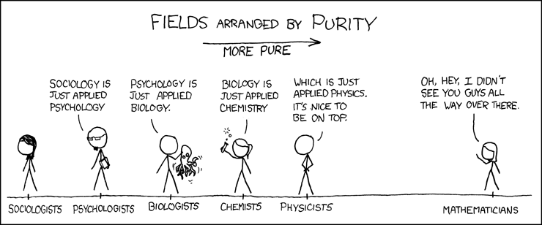
3. The nature of mathematics
(CC BY-NC 2.5 xkcd)
Notes:
(Hersh, ?)

Slide 13
3. The nature of mathematics
“The Myth of Neutrality: Mathematics Education is Political” (Martin et al, 2010)
We don’t have all the answers – a pluralist approach to mathematics
We don’t have to do it alone – mathematics and statistics in/for other subjects
Argumentation and contestation – suggests agonistic democracy as a pedagogy.

Slide 14
An agonistic account of democracy
“an emphasis on the values of constitutive pluralism, robust contestation and enduring tragedy, where the latter entails recognition of the ineliminable nature of (political) conflict … without the expectation of finding any final or perfect solutions and; an acceptance of difference and disagreement as constitutive and constructive elements …”
(Hammersley-Fletcher et al, 2018)
Notes:
Related pedagogic ideas: Trust, Transparency, Tolerance, Honesty, Humility, Ambiguity, Uncertainty, …
Role of a vanishing mediator.

Slide 15
References
Civil, M. (1994). Connecting the home and school: Funds of knowledge for mathematics teaching and learning. Draft. Paper presented at the annual meeting of the American Educational Research Association, New Orleans, LA. (ERIC Document Reproduction Service No. ED 370 987)
Ernest, P. (1991). Mathematics teacher education and quality. Assessment and Evaluation in Higher Education, 16(1), 56–65.
Ghosh, S. (2021). What motivates teachers to develop critically informed citizens in the mathematics classroom? Philosophy of Mathematics Education Journal, 37.
Gutstein, E. (2006). Reading and writing the world with mathematics: Toward a pedagogy for social justice. New York: Routledge.
Hammersley-Fletcher L., Clarke, & M., McManus, V. (2018). Agonistic democracy and passionate professional development in teacher-leaders. Cambridge Journal of Education, 48 (5). pp. 591-606.
Kathotia, V., O’Brien, K., & Solomon, Y. (2021). Just mathematics? Fostering empowering and inclusive mathematics classrooms with Realistic Mathematics Education. In D. Kollosche (Ed.), Proceedings of the Eleventh International Mathematics Education and Society Conference (Vol. 1, pp. 376–XX). Tredition.
Martin, D. B., Gholson, M. L., & Leonard, J. (2010). Mathematics as gatekeeper: Power and privilege in the production of knowledge. Journal of Urban Mathematics Education, 3(2), 12–24.
Skovsmose, O. (2021). A philosophy of critical mathematics education. Philosophy of Mathematics Education Journal, 37.

Slide 16
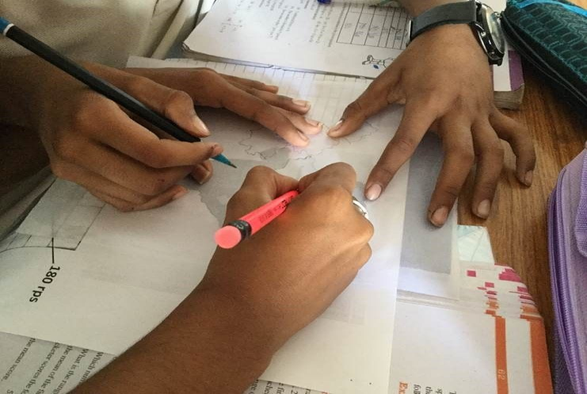
Thank you!

